Slide 1
Working with Pods
Sameer Zulfi

Slide 2
Pod Theory
When I Say VMWARE, your mind will think about Virtual Machine
When I say Docker, your mind will automatically think about Containers
When I say K8S, your mind should think PODS from today
In K8S world, Deploying apps on K8S means deploying it on PODS.
Make sure you understand this fundamental into your brain.
i.e., Virtualization does VMs
Docker does Containers
K8S does Pods

Slide 3
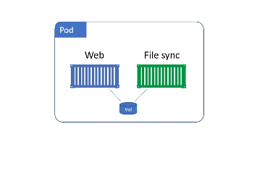
Pods Vs Containers
Pods are just a vehicle for deploying applications
Pods hosts one or more containers
Below diagram tells you two containers in a single Pod sharing a common Volume

Slide 4
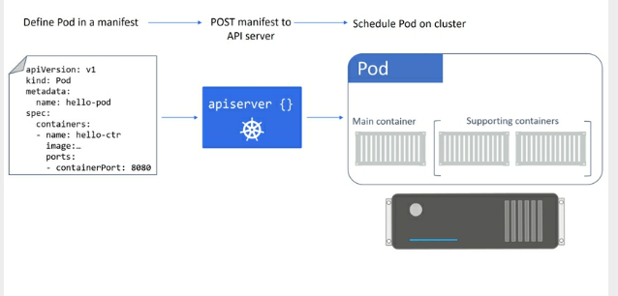
How do we deploy Pods
Hope you remember about manifest file which I discussed earlier ?
Ok. To deploy a Pod to a K8S cluster we define it in a manifest file.
Later POST that manifest file to the API server
Then, the manifest file desired state content will be written to Cluster Store
Then, Scheduler deploys it to a healthy nodes
That’s it. This is the flow.

Slide 5
The Anatomy of a Pod
Pod is a shared execution environment.
Means, Pod has a set of resources which will be shared among the containers inside of it.
These resources include IP addresses, hostname, sockets, memory, volumes etc.,
Some of the POD resources :
Network Namespace : For ex, IP address, port range, routing table
UTS Namespace : Hostname
IPC Namespace : Unix Domain Sockets
This means, All containers in a POD will share a hostname, ip address, memory address space and volume

Slide 6
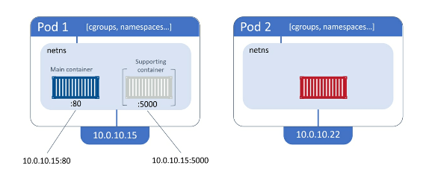
Analyze this

Slide 7
Summary
So Summary is PODS. Everywhere Pods… Pods.. Pods.. Pods.
It’s all about the Pods.
Pods gets deployed.
Pod gets IP.
So POD is the Hero.

Slide 8
Pods and cgroups
At a high level, Control Groups (cgroups) prevent individual containers from consuming all of the available CPU, RAM etc.,
So Cgroups actively monitor the resources usage by the containers

Slide 9
Pod LifeCycle
Hope you remember the flow.
Everything starts with Manifest file.
And POST that into APIServer.
Then it will be stored in ClusterStore.
Scheduler will schedule the POD.
First stage of Pod will be in pending stage as it will download all the required images to start the containers inside the Pod.
Once everything is up and ready, Pod enters the running state.
It is just like your AWS ec2 instance, when you launch it, it will go to pending state first and then it will be in running state.

Slide 10
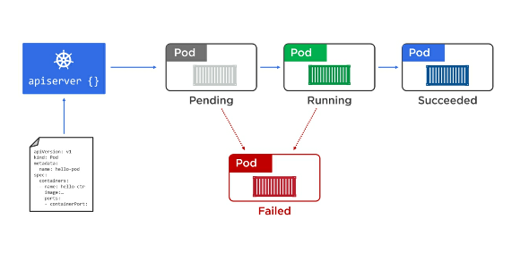
Once it’s done, it enters the succeeded state.
When a Pod can’t start, it can remain in the pending state or go to the failed state.

Slide 11
The concept which I have told you in the previous slides are deployed to Pod via a manifest file.
We call this as Singleton. Means there is no self-healing capabilities.
For this reason, we almost always deploy Pods using Controller like Deployments and DaemonSets
As these can reschedule Pods when they fail.
So Pods are mortal. Means it is not God. It is like a Human-being. When they die , they are gone.
There is not bringing them back from the dead.

Slide 12
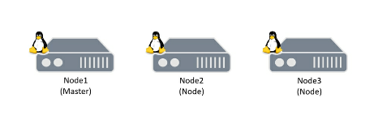
Hands-on with Pods
It’s time to see Pods in Action.
We will use 3 node cluster.
On your Master:
Please create the file name : pod.yml with the side content
apiVersion: v1
kind: Pod
metadata:
name: hello-pod
labels:
zone: prod
version: v1
spec:
containers:
- name: hello-ctr
image: nigelpoulton/k8sbook:latest
ports:
- containerPort: 8080

Slide 13
What this YAML file is describing?
4 top level resources are there.
Apiversion.. We are using version 1
Kind.. We are going to deploy a “pod” object
Metadata.. Name of the pod and assigning two labels to it.
Spec.. Define the containers details. For ex which image, which port etc.,

Slide 14
Deploying pods to a manifest file
We have our manifest file called pod.yml
Use kubectl command to post this pod.yml file to API server
kubectl apply –f pod.yml
The above command will create a pod. Pod name will be hello-pod
Pod will take sometime to come in READY status as it needs to pull the images
Run the below command
kubectl get pods
Congraulations, Your Pod has been scheduled to a healthy node in the cluster and is being monitored by the kubelet process.
Kubelet process is the Kubernetes agent running on the node

Slide 15
Introspecting running Pods
Try this command and see what happens
kubectl get pods hello-pod –o yaml
Kubectl get pods hello-pod –o wide
So the –o wide gives you extra column and extra information
And –o yaml will give you some extra information in your manifest file.
In that .spec ( desired state ) & .status ( current state )
So this manifest file will add few more lines and called it as status section which is nothing our current state.
Try this command and see what happened
Kubectl describe pods hello-pod

Slide 16
Let’s try this command
Kubectl exec hello-pod ps aux
What happens when you run the below command ?
Kubectl exec –it hello-pod sh
If you are inside the container and want to come out, please run the below command
Exit
Now if you want to delete the pod, pls run the below command
Kubectl delete –f pod.yml

